Slide 1
Direct Memory Access (DMA)
What is DMA and why do we use it?
Alternatives to using DMA.
  CPU Polling + Data Transfer.
  Interrupt Driven Requests + Data Transfer.
DMA controllers - Protocol of Acquiring the Bus.
  Transfers between IO and Memory.
  Transfers between IO devices.
  Transfers from Memory to Memory.
DMA modes of operation
  Burst vs. Interleaved Operation.
  Registers vs. Descriptors: Chaining and Linked List.
  Auto-repeat DMA : Steaming.
  Scatter-Gather transfers.
©Paul Davies. Not to be copied, used, or revised without explicit written permission from the copyright owner.
This lecture may contain animations and is best viewed as a slide show
Notes:
dfghdfgh

Slide 2
What is DMA?
DMA or Direct Memory Access is a process whereby a slave device (a DMA controller) is able to take over control of the main CPU system buses, (address, data and control) and become a Bus Master able to initiate rapid transfers of data between the Memory and IO subsystems without the need for the CPU to become involved.
Why is it Used?
It leads to greater performance because:-
DMA controllers are more efficient at transferring large blocks of data than a CPU trying to do the same thing using software.
For example, in a multi-tasking operating system environment like LINUX or Windows, a thread requesting a data transfer from say a disk drive or network can be suspended by the Operating System (OS), and the DMA controller can perform the data transfer in the background.
The OS could, while waiting for the transfer to take place, perform a context swap and run another thread that is not waiting for IO.
Once the transfer has completed the DMA could release the bus and interrupt the CPU. The OS could then context switch back to the waiting task.

Slide 3
Why can’t the CPU perform the transfer as efficiently as DMA?
Consider how such transfers would have to take place under the control of a program.
Without a DMA controller there are two means a program could be written to transfer blocks of data between IO devices and memory.
  Data Polling.
  Data Transfer using Interrupt Driven IO.

Slide 4
Consider Polling – A Large Software Bottleneck
Consider transferring a block of data from say a disk drive (>50MB/sec) or a network (>100MB/sec) to memory one byte at a time under software control.
The following algorithm gives an indication of what would be required of the program.
The user program starts by calling the kernel with a read request, which invokes the device driver to transfer the data from the hardware device into memory.
Kernel Call Read(addr, count)
Program the Disk controller
do {
Poll disk controller for the next byte
Read byte from disk controller (via device driver)
Write byte to program memory
Increment memory address
Decrement count
} while (count != 0) ;
Hard
Disk
Controller
main()
{
. . .
. . .
}
Disk
Device
Driver
device1
Disk1
device1
Command
device1
Command
Disk2
Data
Data
device1
Software Driver transfers data from disk controller back to Kernel
Disk Controller transfers data between device driver and disk
Serial ATA, SCSI, IDE Interface Burst data to Disk controller
Kernel
Call
Kernel transfers data from driver to user Program Variables
Main Prog
Program
Data &
Variables
CPU
It is easy to see that only a fraction of the processing power of the CPU is being used for the actual transfer of data. Most of the time is being used to read the next instruction or is wasted in a polling loop (that’s ignoring the code in the device driver which is also an overhead). While it’s doing this the CPU is 100% busy
The speed of the data transfer is limited by the speed of the processor, i.e. the processor has become a bottleneck limiting data transfer rates.
After Read() call the data has been transferred from disk to program variables
main( )
{
Read(addr, count);
. . . .
. . . .
}
main()
{
. . .
. . .
}

Slide 5
Interrupt Driven Data Transfer – Just as big of a Software Bottleneck
Generating an Interrupt per item of data transfer is even worse!!
Data still has to be transferred via software inside the interrupt service routine (ISR) for the device driver but now we have the overhead of calling the ISR for each byte/sector or whatever transferred.
CPU Interrupt
Kernel Call ‘Read()’
Serial ATA, SCSI, IDE Interface
Program Hard Disk Controller via driver
Install interrupt handler
Wait for completion
Disk
Device
Driver
Hard
Disk
Controller
device1
device1
Disk1
device1
Command
Command
Device Driver ISR
Disk2
Read byte from disk controller
Write byte to program memory
Increment memory address
Decrement byte count
device1
Data
Data
Data
Software Driver transfers data from Hard disk controller back to Kernel
Disk Controller transfers data between device driver and disk
Serial ATA, SCSI, IDE Interface Burst data to Disk controller
Program
Data &
Variables
CPU
Kernel
Call
main()
{
. . .
. . .
}
After Read() call, the data has been transferred from disk to program variables by the ISR
main( )
{
Read(addr, size);
. . . .
. . . .
}

Slide 6
How has DMA been traditionally Performed?
DMA has traditionally performed by a dedicated hardware chip called a DMA controller (DMAC).
DMACs are able to transfer data at high speed between memory and/or DMA capable IO devices without the intervention of the CPU.
A DMAC is a peripheral/slave device which can be programmed to carry out the transfer.
DMACs differ from most other slave devices as they are able to take over and drive the main system buses [Address, Data and Control buses].
Notice how the address, and control buses of the DMAC are bi-directional.
The DMAC is able to emulate the signals, protocols and timing of the host CPU so that it can control memory and other slave devices.
In modern high performance processors the DMA controller may be integrated into the same chip as the CPU and may be able to burst data from IO device into DDR ram at speeds > 15Gbytes/sec.
Bi-directional address, data and control buses to DMA controller.
CPU
Control
DMAC
Address
Data
IO
Controller
(Disk,
Comms etc.)
Memory
IO
Controller
(Disk,
Comms etc.)

Slide 7
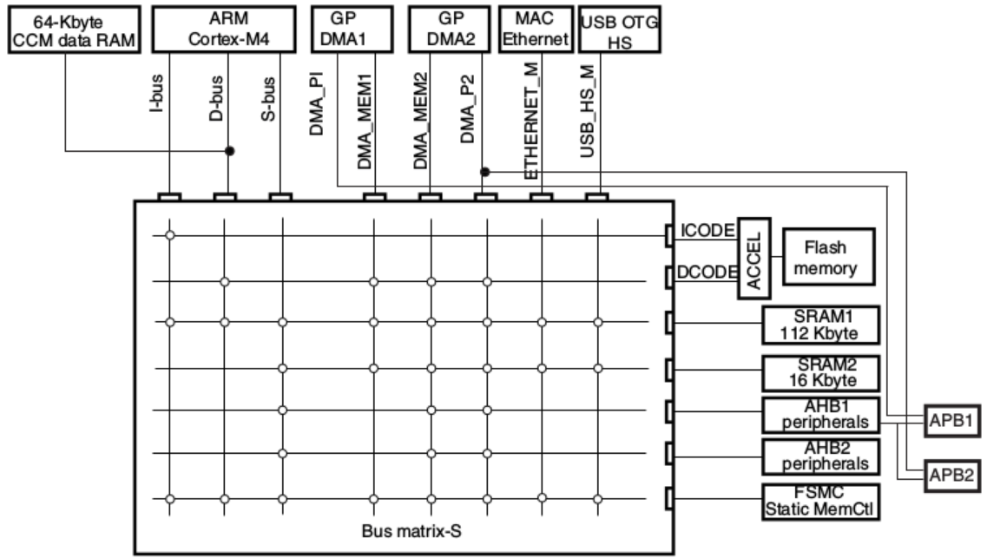
Traditionally, DMACs were separate chips sitting alongside a traditional micro-processor e.g. the 68450 for 68k based systems or the 8037/8257/8257 family for Intel x86 processors.
With highly integrated uC’s, DMACs are now on the same chip.
We see this in the example ARM based uC below, which has two general purpose DMA controllers that link memory to a range of peripherals (configurable)

Slide 8
How does a Traditional DMAC Control the Bus?
Two approaches commonly used :-
  Kick the CPU off the bus using some kind of Bus Request/Bus Grant protocol as outlined below (the exact details vary between CPUs).
    DMAC asserts the CPU’s Bus Request (BR*) input when ready to transfer
    CPU responds by tri-stating it’s data, address and control buses and asserting Bus Grant (BG*).
    DMAC responds by asserting CPU’s Bus Grant Acknowledge (BGACK*) to indicate it has taken control of the bus.
    When the slave has finished, it relinquishes control back to the 68000 by negating BGACK*. The CPU then takes back control of the bus and resumes processing.
    Use Prioritised Arbitration: DMAC interleaves with CPU accesses
    CPU and DMAC continue to work together, competing for use of the bus.
    This approach is more common now that CPU’s have caches and can continue to execute code when DMAC has control of the bus and main memory.

Slide 9
Traditional Centralised Bus Request/Bus Grant Approach : 68k Example
BR*
I would like the bus
BR*
BG*
You can have the Bus
BG*
BGACK*
I have the bus
BGACK*
Transfer Complete Interrupt
IRQ*
IPL0*- IPL2*
Control
Control
Address
Address
68000
DMAC
Data
Data
DMA Drives the system buses
CPU Tri-states system buses
Data Transfer
Interrupt at end of transfer signifies DMA is complete. An OS can use this to wake up the waiting task and perform a task swap.

Slide 10
Traditional Centralised Bus Arbitration Approach (any CPU e.g. 68k, x86, ARM)
Here arbitration is performed whenever CPU and DMAC issue an external address indicating they wish to use the shared system bus (i.e. memory or IO).
Processor and DMAC interleave accesses. Dtack used to delay/grant transfer.
Existence of CPU caches reduces competition for the bus and makes this a better modern day approach.
CPU
DMAC
CPU
CPU
Cache
Cache
Dtack
Dtack
CPU Bus
Dual Port Arbiter + Bus Mux
DMAC Bus
Shared System Bus
Main Memory (Dram)
Hard Disk Controller
Network Controller

Slide 11
DMA Controller Signals and Architecture
Architecture of a generic 68000 compatible DMAC (traditional approach)
DMAC uses registers to control data transfer.
As a memory mapped peripheral, DMAC needs a chip select signal derived from an address decoder
Programmed by CPU with the number of bytes that need to be transferred.
CS*
AS*
Byte Count Register
Standard 68000 Interface. Note bi-directional nature of control and address buses.
This device is a potential bus master (as well as a memory mapped peripheral) capable of taking over the system buses and driving the data, address and control signals just like the 68000
DTACK*
Byte Count Register
Programmed by CPU with the Source Address
R/W*
Memory Source Addr
LDS*
Memory Starting Addr
UDS*
Programmed by CPU with the Destination Address
Memory Dest Addr
Memory Starting Addr
Data Bus [0..15]
Command Register
Command Register
Controls mode of transfer
Memory to IO,
IO to Memory,
IO to IO
Memory to Memory
Address Bus[1..23]
Status Register
Command Register
BG*
DMAC
Bus request and allocation signals
BR*
BGACK*
IRQ*
Interrupt Request at end of transfer to tell CPU that data transfer has been completed

Slide 12
Typical DMAC Channel Between IO and Memory
In response to REQ* from IO Device, DMA controller takes control of the CPU bus
IO Device requests a DMA transfer by asserting a DMA Request
DMA Request and Data Handshaking Signals
DMA controller asserts ACK* back to IO device when it has control of CPU bus
IO device may assert Done to indicate transfer is complete
DMA controller can assert Done to abort a DMA transfer or indicate it is complete
REQ*
DMA Request
IO Device asserts Data Ready/Latched to indicate that it has placed new data on the data bus during a transfer from IO to Memory OR has latched the current Data on the Data bus during a transfer from Memory to IO
DMA controller asserts DTC* to request next byte from IO Device during transfer from IO device or to tell IO device to latch next byte during transfer to IO Device
ACK*
DMA Acknowledge
Done
Done
RDY*
Data Ready/Latched
DMA controller only supplies memory address and control signals during transfer. Data is driven by memory or IO device
DMAC
DTC*
Data Transfer Complete
DTACK*
DMA Capable IO Device e.g. Hard Disk Controller
R/W*
AS*
LDS*
UDS*
DMA Capable Peripheral controller Supplies/Latches Data during transfer
Address Bus [1-23]
Data Bus [0..15]
Memory Subsystem
Memory Subsystem

Slide 13
Direct Memory Access Transfers
Note DMA can be used to transfer data from Memory to Peripheral or from Peripheral to Memory
Fly-by DMA (demonstrated in the animation below) allows the data to be read from the IO and transferred to the Memory in one bus cycle, this is not always supported by all controllers but is the fastest way to do it; if not a read of the IO is done and a temporary copy of the data is made internally by the DMAC then it is transferred to memory with a second write bus cycle.
DMA Controller Requests Bus from CPU
DMA Controller Says Go to Disk Controller
Disk controller requests data from disk drive
DMA Controller Takes Bus
Disk Controller Requests DMA Transfer
CPU Vacates Bus
Read Request to Disk issued and DMA controller programmed to perform the transfer by OS
Sector/track request
BR*
BR*
Hard Disk
REQ*
DMA Request
Hard Disk
BG*
BG*
ACK*
DMA Acknowledge
Transfer
Ready
BGACK*
BGACK*
Count = 2
Done
Transfer Complete
Count = 0
Count = 1
IPL0*- IPL2*
IRQ*
Addr = 1002
RDY*
Data Ready/Latched
Addr = 1000
Addr = 1001
DMAC issues IRQ to indicate transfer completed
DCT*
Data Transferred
55
DMAC
FC
DTACK*
DMA Capable Hard Disk Controller
68000
Disk Gets Data
Disk Gives Data to Disk Controller
R/W*
LDS*
UDS*
Disk Indicates data Ready for Transfer
AS*
Address Bus
Disk Controller puts data on Data Bus and Tells DMAC
Data Bus
1000
1001
CPU Retakes Bus
FC
55
Address
Memory Subsystem
Memory Subsystem
DMA Controller Carries out a write bus cycle to Memory
Data
Control

Slide 14
Peripheral to Peripheral Transfers using DMA
If the DMA controller has two or more IO channels, then transfers between peripherals are possible, e.g. from a Hard disk to Network controller for example.
Network controller has to be programmed by CPU to receive data via DMA, disk controller has to be programmed to supply data via a DMA and DMAC has to be programmed to transfer data from Channel 1 to Channel 2
REQ*
DMA Request
Hard Disk
ACK*
DMA Acknowledge
Channel1
Done
Transfer Complete
RDY*
Data Ready
55
DTC*
Data Transferred
Disk Controller
IO to IO: 1 byte
IRQ*
IO to IO: 1 byte
55
Data Bus
REQ*
DMA Request
Network
ACK*
DMA Acknowledge
Channel2
Done
Transfer Complete
RDY*
Data Latched
55
DTC*
Data Available
DMAC
Network Controller

Slide 15
DMA Memory to Memory Transfers
DMAC Latches Data
Count Decremented
Source Address Incremented
Data = ?
Data = FC
Count = 1
Count = 0
Source Address = 1000
Destination Address Incremented
Source Address = 1001
Destination Address = 5001
Destination Address = 5000
IRQ*
DMAC
R/W*
LDS*
UDS*
DTACK*
AS*
Address Bus
Data Bus
5000
FC
1000
FC
Memory Supplies Source Data
DMAC Reads from source Address
Memory Subsystem
Memory Subsystem
DMAC Supplies Destination Data
DMAC Writes to Desination Address
Memory to Memory Transfers always takes 2 bus cycles
Typical IO to Memory Transfer Operation

Slide 16
DMAC Modes: Interleaved vs. Burst
DMACs can be programmed to consume a variable percentage of the available memory bandwidth of the system in order to carry out their transfers. There are two modes
  Burst
  Interleaved
In ‘burst’ mode a DMAC could consume 100% of the memory bandwidth to carry out the transfer. The CPU performance may be impaired until completion if it doesn’t have a cache.
This may upset the operation of a real-time system where the CPU may not be able to react to an event or interrupt if a DMA in progress and may miss its response time.
For this reason most DMA controllers can be programmed to interleave their operation with that of the CPU, a form of Interleaved “Cycle Stealing” whereby a byte is transferred while the CPU is not using the bus or maybe it alternates with it CPU-DMAC-CPU-DMAC etc. as in the Arbitration approach.

Slide 17
DMA concepts on Modern High Performance Bus Based Systems
The traditional centralised dedicated DMA controller has largely disappeared from high performance bus based computer systems such as PCI and VME and has been replaced by a device specific, de-centralised approach (it does however live on in uC’s).
Here each IO device on the bus is a potential bus master able to carry out it’s own DMA transfers. Additionally, each device’s DMA engine can be specifically optimized for the sort of DMA transfers it performs and the burst modes supported by Ram and IO.
Such an approach allows multiple DMA requests to be initiated simultaneously.
CPU
CPU
Arbiter and Memory Controller
Main Memory (Dram)
Cache
Cache
Shared System Bus
DMA Engine
DMA Engine
DMA Engine
DMA Engine
Hard Disk Controller
Network Controller
USB Controller
SPI and Canbus

Slide 18
DMA Concepts in PCIe
PCIe turned the conventional PCI bus from a bus architecture into a serial, packet-switched, point-to-point architecture very similar to packet-switched networks.
PCIe connects each device with a dedicated, bi-directional link to a PCIe switch. As a result, PCIe supports full duplex DMA transfers of multiple devices at the same time. All arbitration logic is replaced by the packet routing logic inside the PCIe switches.
CPU
CPU
PCIe Root Complex
Main Memory (Dram)
Cache
Cache
PCIe
Switch
PCIe
Switch
DMA Engine
DMA Engine
DMA Engine
DMA Engine
Hard Disk Controller
Network Controller
USB Controller
SPI and Canbus
https://geidav.wordpress.com/2014/04/27/an-overview-of-direct-memory-access/

Slide 19
Chained and Linked List Transfer Descriptors
Most modern DMACs do not rely on simple internal registers to control transfers. Rather, they use DMA Descriptors, set up in memory.
Because the DMAC can gain control the system bus (with access to main memory), the DMAC can actually read and interpret the descriptors and carry out multiple transfers, one after the other by reading a sequence of descriptors.
These descriptors essentially contain the same information as a register based model but are maintained in system memory instead.
Such tables are useful for performing a sequence of DMA transfers back to back. This allows the CPU to set up a series of transfers in memory and let the DMA process them, rather than having to wait for each one to complete before setting up the next.

Slide 20
Example Chained Descriptor Model
MEMORY
CPU
SUPPLIES
DEVICE ADDRESS
BASE ADDRESS
BASE COUNT
Block D
COUNT D
MEMORY
DESTINATION
OR SOURCE
INITIAL BASE
ADDRESS OF
DESCRIPTORS
MEMORY ADDRESS A
MEMORY COUNT A
MEMORY ADDRESS B
Block B
COUNT B
MEMORY COUNT B
BASE COUNT = 4
MEMORY ADDRESS C
DMAC
MEMORY COUNT C
MEMORY ADDRESS D
MEMORY COUNT D
Block C
COUNT C
DESTINATION
OR SOURCE
Block A
COUNT A
DEVICE
OR
MEMORY

Slide 21
Example Linked Descriptor Model
MEMORY
CPU
MEMORY
SUPPLIES
DEVICE ADDRESS
BASE ADDRESS
Block D
COUNT D
INITIAL BASE
ADDRESS OF
DESCRIPTORS
MEMORY ADDRESS A
DESTINATION
OR SOURCE
MEMORY COUNT A
LINK TO B
Block B
COUNT B
MEMORY ADDRESS B
MEMORY COUNT B
LINK TO C
DMAC
MEMORY ADDRESS C
MEMORY COUNT C
Block C
COUNT C
LINK TO D
DESTINATION
OR SOURCE
MEMORY ADDRESS B
MEMORY COUNT B
Block A
COUNT A
NULL
DEVICE
OR
MEMORY

Slide 22
Auto Load DMA Transfers for Streaming
An Auto load feature allows a DMA controller to repeat DMA transfers over and over by performing the same transfers once the previous transfer has completed, i.e. without the intervention of the CPU.
This mode is useful in a number of ways e.g continuously streaming:-
  Image data from Memory to a Display (see next slide)
  Analog data to a DAC (to repeat a waveform)
  ADC data to memory (continuous data acquisition)

Slide 23
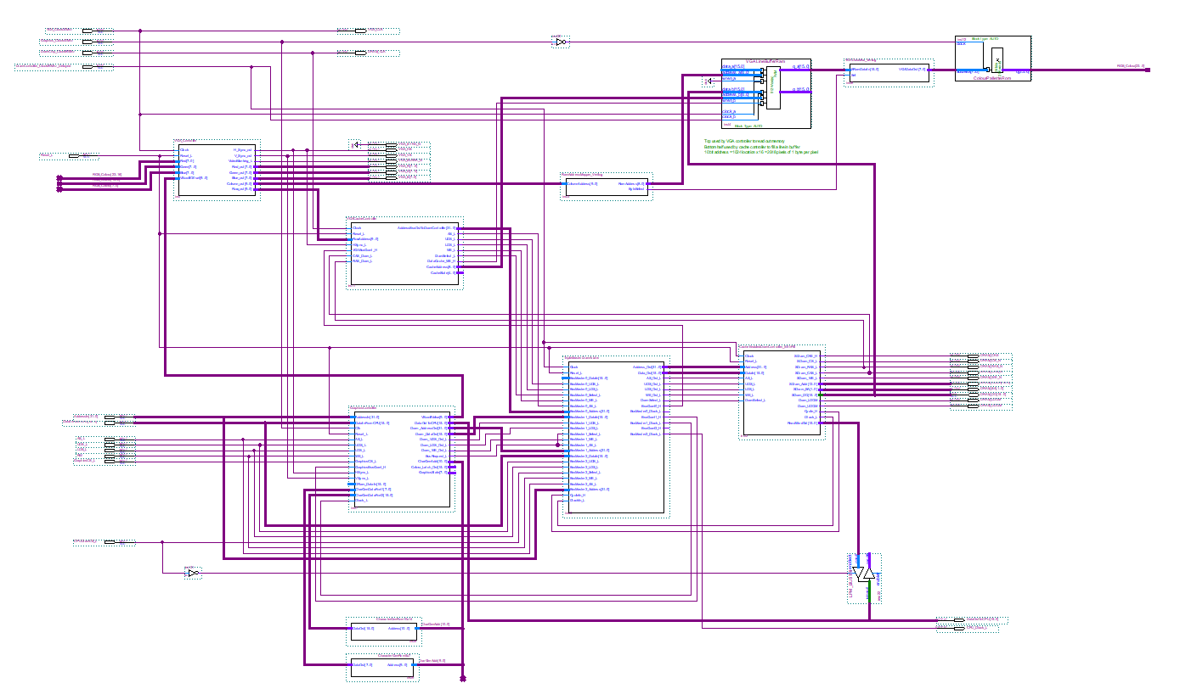
DMA Controller Bursts data from Dram Memory Frame Buffer into Row buffer at start of each HSync. This creates bandwidth for Graphics to Write to Frame buffer while Row buffer content is output to Display.
RGB output to Display
Row Buffer
DMA Transfer with Auto Load
VGA Cont
DMA
Dram Memory
Frame Buffer
Graphics
Dram
Cont
Arbiter
Example DMA used in Dram Based Graphics Controller

Slide 24
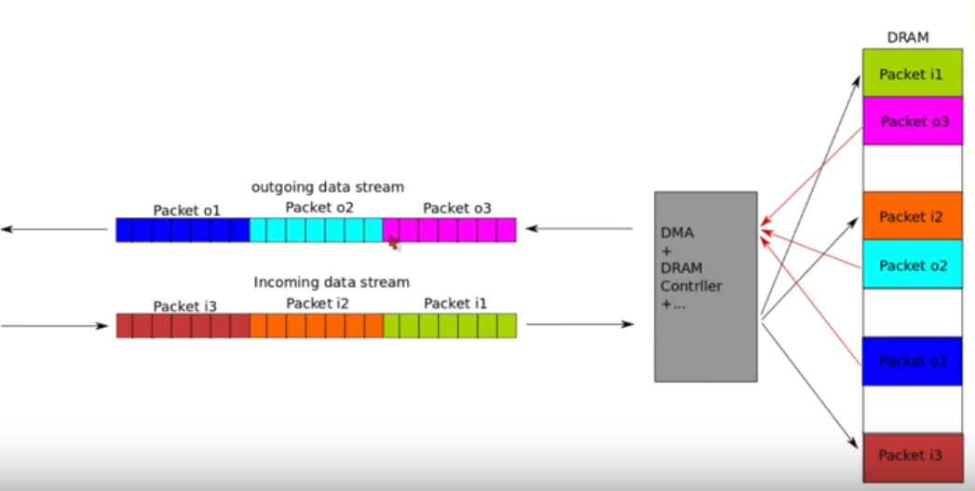
Scatter Gather DMA Transfers
Using DMA descriptor tables, a DMA controller can be programmed to gather data, e.g. packets from say an Ethernet controller, USB or ADC and store (scatter) them into distributed areas of Dram where the processes that requested them can act on it later.
In reverse, data that is scattered around in memory can be “gathered” ready to stream to an output device e.g. write requests from processes to disk or network.
Both approaches can help in Virtual address (user program space) to Physical address (DMAC memory space) translation.

Slide 25
DMA and Caches
Use of DMA can result in main memory and a CPU data cache becoming inconsistent (e.g. DMA updates the main memory, but CPU data cache is not)
2 Solutions
  Cache can “snoop” the DMA transfer and if a write to memory is detected either:-
    Update the cache with the new data or
    Invalidate the cache lines holding that data, forcing new data to be loaded when accessed by CPU later (after the transfer)
  If snooping is not an option, the OS could invalidate or flush the CPU cache prior to the transfer. This would of course eliminate any inconsistencies, but results in a lot of traffic as any changed cache data would have to be written first. The new transferred data would then be brought into the cache with each subsequent CPU cache “miss”.

